Slide 1
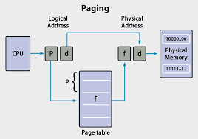
PAGING
BY :- SAKSHI JAISWAL (21229CMP003)

Slide 2
WHAT IS PAGING?
Paging is a memory management technique in operating systems that enables processes to access more memory than is physically available.
In paging, the operating system retrieves processes from secondary storage into main memory in the form of fixed-size blocks called pages.
Paging is a logical concept. It's important for the implementation of virtual memory.
Notes:
© Copyright Showeet.com – Free PowerPoint Templates

Slide 3
Some terms involved in paging are:
Logical Address (Virtual Address): It is represented in bits and is the address generated by the CPU.
Logical Address Space (Virtual Address Space): It is represented in words/bytes and is the set of all the logical addresses that a program generates.
Physical Address: It is represented in bits and is an address that is actually present on the memory unit.
Physical Address Space: It is represented in words/bytes and is a set of physical addresses that correspond to logical addresses.

Slide 4
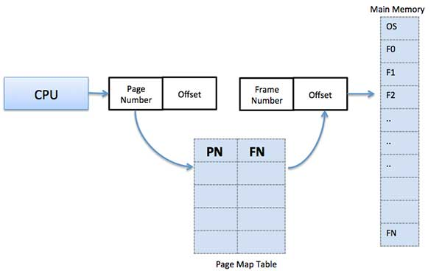
Paging Technique in Operating system
Paging technique is the mapping done from virtual address to physical address by the MMU (a hardware device). The Physical Address Space is divided into multiple fixed-size blocks. These blocks are called frames. Whereas, Logical address Space is divided into fixed-size pages. Here the size of a page is equal to the size of a frame which allows maximum utilization of the main memory and avoids external fragmentation.
A data structure called a page map table is used to keep track of the relation between a page of a process to a frame in physical memory.

Slide 5
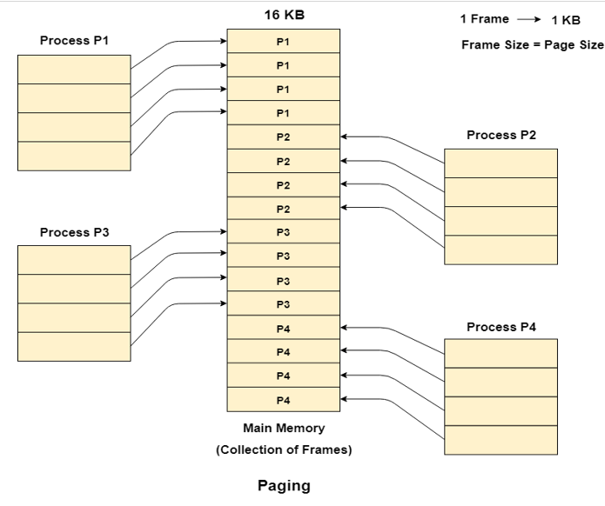
Large Image slide
Notes:
© Copyright Showeet.com – Free PowerPoint Templates

Slide 6
The address generated by a CPU is divided into:
Page number(p): This is the number of bits that represent the pages in Logical Address Space or Page number.
2. Page offset(d): This is the number of bits that represent a particular word in a page or the page size of Logical Address Space or page offset.
We can divide Physical Address into:
1. Frame number(f): This is the number of bits that represent the frame of Physical Address Space or Frame number.
2. Frame offset(d): This is the number of bits that represent a particular word in a frame or frame size of Physical Address Space or frame offset.

Slide 7

The logical address is as follows:
where p indicates the index into the page table, and d indicates the displacement within the page.
Physical Address = Frame number + page offset

Slide 8
Advantages of Paging
The memory management algorithm is easy to use.
External Fragmentation is not required.
Swapping between equal-sized pages and page frames becomes easier.

Slide 9
DISADVANTAGES OF PAGING
Internal fragmentation.
Additional memory consumption by Page tables.
Memory reference overhead due to multi-level paging.

Slide 10
Why Segmentation is required?
Paging is closer to the Operating system. Regardless of the fact that a process may contain some related functional components that must be loaded in the same page, it divides all processes into pages.
The user's perspective of the process is irrelevant to the operating system. The same function might be split up into different pages, which might or might not be loaded into memory simultaneously. The system's effectiveness is reduced.
It is preferable to have segmentation in the operating system that breaks the process up into parts. The functions in each segment are of the same type; for example, the main function may be included in one segment, while library functions may be included in another.

Slide 11
SEGMENTATION
Segmentation is a memory management technique in which the memory is divided into the variable size parts. Each part is known as a segment which can be allocated to a process.
The details about each segment are stored in a table called a segment table. Segment table is stored in one (or many) of the segments.
Segment table contains mainly two information about segment:
Base: It is the base address of the segment
Limit: It is the length of the segment.

Slide 12
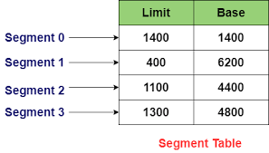
SEGMENT TABLE
It maps a two-dimensional Logical address into a one-dimensional Physical address. It’s each table entry has:
Base Address: It contains the starting physical address where the segments reside in memory.
Segment Limit: Also known as segment offset. It specifies the length of the segment.

Slide 13
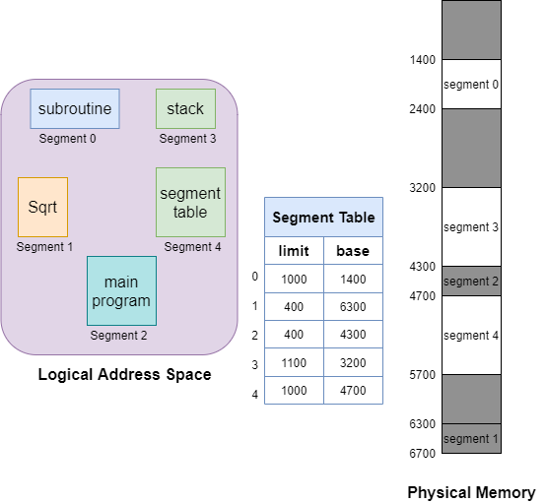

Slide 14
Advantages of Segmentation
No internal fragmentation
Average Segment Size is larger than the actual page size.
Less overhead
It is easier to relocate segments than entire address space.
The segment table is of lesser size as compared to the page table in paging.
Disadvantages
It can have external fragmentation.
it is difficult to allocate contiguous memory to variable sized partition.
Costly memory management algorithms.

Slide 15




THANK
YOU
HOPE!
YOU LIKED THE PRESENTATION.
SAKSHI JAISWAL
SAKSHI JAISWAL
21229CMP003

